Slide 1
Linux Modules
Mohd. Saqib, 14BCS0042
Najeeb Khan, 14BCS0043
Rahul Tuteja, 14BCS0045

Slide 2
Part I
History of Linux
Kernel
Linux Kernel Module
User Space and Kernel Space
Modules vs Programs

Slide 3


A peek into the past of Linux….
Linux is a Unix-like computer operating system assembled under the model of free and open-source software development and distribution. The defining component of Linux is the Linux kernel, an operating system kernel first released on September 17, 1991 by Linus Torvalds. The development of Linux is one of the most prominent examples of free and open-source software collaboration. The underlying source code may be used, modified and distributed— commercially or non-commercially— by anyone under the terms of its respective licenses, such as the GNU General Public License.

Slide 4
What is a Kernel then?
According to Wikipedia,
“ The kernel is a computer program that is the core of a computer's operating system, with complete control over everything. It is the first program loaded on startup. It handles the rest of startup as well as input/output requests from software, translating them into instructions for the central processing unit. It handles memory and peripherals like keyboards, monitors, printers, speakers.”
Above image shows kernel in an open source environment.

Slide 5

What is a Kernel Module?
A loadable kernel module (LKM) is a mechanism for adding code to, or removing code from, the Linux kernel at run time. They are ideal for device drivers, enabling the kernel to communicate with the hardware without it having to know how the hardware works. The alternative to LKMs would be to build the code for each and every driver into the Linux kernel.

Slide 6
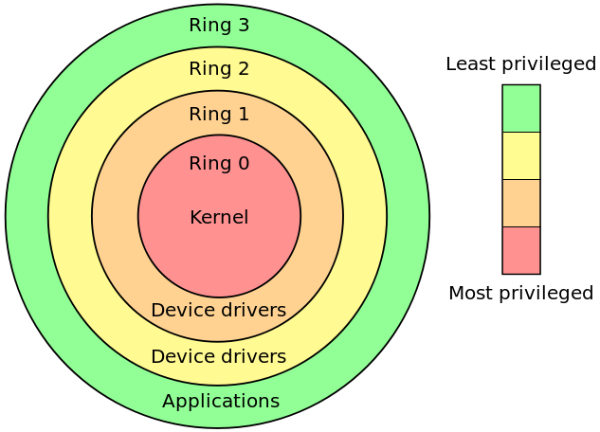
Kernel Space and User Space
A modern computer operating system usually segregates virtual memory into kernel space and user space. Primarily, this separation serves to provide memory protection and hardware protection from malicious or errant software behaviour.
Kernel space is strictly reserved for running a privileged operating system kernel, kernel extensions, and most device drivers. In contrast, user space is the memory area where application software and some drivers execute.
The most common way of implementing a user mode separate from kernel mode involves operating system protection rings which segregates the access to the resources to different levels.

Slide 7
Modules v/s Programs
Do not execute sequentially— a kernel module registers itself to handle requests using its initialization function, which runs and then terminates,using cleanup function. This is quite similar to the event-driven programming model that is commonly utilized in graphical-user interface (GUI) applications(like Android Applications).
Do not have automatic cleanup — any resources that are allocated to the module must be manually released when the module is unloaded, or they may be unavailable until a system reboots.
Do not have printf() functions — kernel code cannot access libraries of code that is written for the Linux user space. The kernel module lives and runs in kernel space, which has its own memory address space. We do however have a printk() function that can output information, which can be viewed from within user space.

Slide 8
Continued...
Have a higher level of Execution Privilege — typically, more CPU cycles are allocated to kernel modules than to user-space programs. This sounds like an advantage, however, you have to be very careful that your module does not adversely affect the overall performance of your system.
Do not have floating-point support — it is kernel code that uses traps to transition from integer to floating-point mode for your user space applications. However, it is very difficult to perform these traps in kernel space. The alternative is to manually save and restore floating point operations — a task that is best avoided and left to your user-space code.

Slide 9
Part II
Header Files
Initialisation Functions
Cleanup Functions
Generalized structure of a module
Makefiles

Slide 10
Header Files:
How to get Linux Headers: sudo apt-get install linux-headers-$(uname -r)
linux/module.h : Every linux module includes this file as this file allows one to compile the code against the linux kernel and hence effectively guaranteeing the status of a kernel module
linux/kernel.h : Error and warning messages are printed in the log file. Printing of the errors/warnings require KERN_INFO which is present in this file. In general kernel related functions are present in this file.
linux/init.h : This header file provides for the macros which are needed for the running the initialisation and cleanup modules of the module(covered next).

Slide 11
Initialisation Functions:
Kernel modules must have at least two functions one of which is a "start" (initialization) function called init_module() which is called when the module is “insmoded” into the kernel.
The module on being called perform the required function, for example, writing the error/warning logs for successful or unsuccessful execution of the module or may interact with the device when acting as a device driver.
Typically, init_module() either registers a handler for something with the kernel, or it replaces one of the kernel functions with its own code (usually code to do something and then call the original function) which can be understood from the fact that it acts as a device driver.
As of Linux 2.4, it is possible to rename the initialisation function and they no longer needs to be called init_module(). This is done with the help of module_init() macros which are included in linux/init.h

Slide 12
Cleanup Functions:
Kernel modules must have at least two functions second one is an "end" (cleanup) function called cleanup_module() which is called just before it is rmmoded which is called when the module is “insmoded” into the kernel.
The cleanup_module() function is supposed to undo whatever init_module() did, so the module can be unloaded safely.

Slide 13
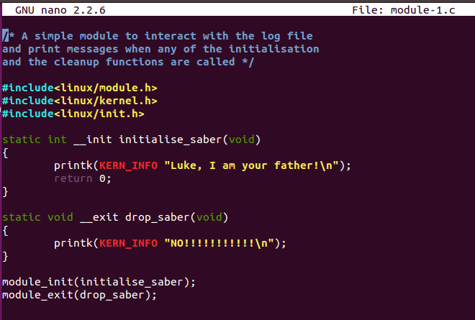
Generalized structure of a module...

Slide 14
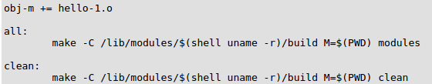
MakeFiles:
The first line of this Makefile is called a goal definition and it defines the module to be built (hello-1.o). The syntax is surprisingly intricate, for example obj-m defines a loadable module goal.
$(shell uname -r) return the current
kernel build version.
M=$(PWD) variable assignment t tells the make command where e actual project files exist.

Slide 15
Part III
The Experiment

Slide 16

How do Modules get into Kernel?
Before we begin….
When the kernel needs a module that is not present in itself then it executes modprobe to load the module in. modprobe finds the alias of the generic filename passed in its configuration file /etc/modprobe.conf. Before executing the respective module, the dependencies for the same are checked in /lib/modules/version/modules.dep. Modprobe uses the insmod command to load any of the prerequisite modules into the kernel.

Slide 17
Materials
A computing device (Laptop/PC)
Virtual machine
Linux Operating System Installed
Not so simple programming skills
Found around the Internet!

Slide 18
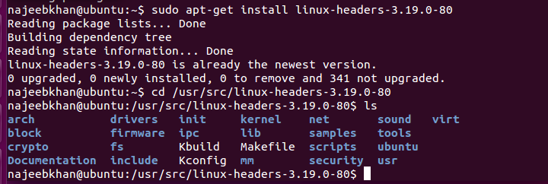
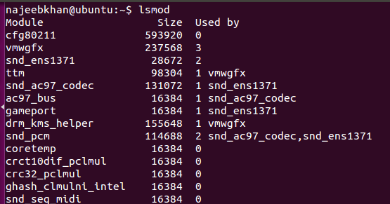
Preparing the system to build LKMs….
It is imperative that you have linux headers installed in your system. A simple package manager (apt-get) will suffice to secure the headers. Check for the linux headers installed in /usr/src folder. You may find a directory for linux headers as depicted below.
Once you are done installing the header use the lsmod command to check for the modules present in your system.
This can act as a sanity check to ensure that various commands used by kernel to insert modules are working properly or not. You may get output somewhat like this

Slide 19
Writing a kernel module
A simple module...
Purpose of this program
Get a gist of what parts make up a kernel module
Interaction of the module with the log files
How initialisation function and cleanup function works
A simple module will write some messages in the log file. Following is the code structure to write a simple module
Include the standard linux headers
Under initialisation function enter the string to be printed using printk() function
Under the cleanup function print another message using the same function
Call each of the initialization and cleanup function using module init macro.

Slide 20
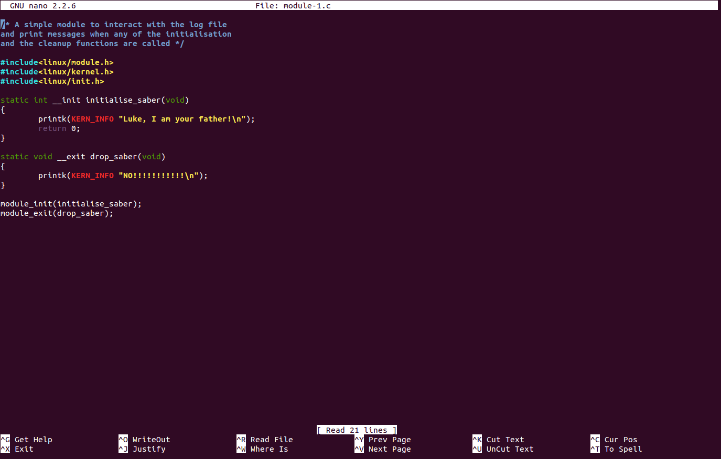

Slide 21
Writing a kernel module
A module with License and Documentation...
Purpose of this program
How linux kernel module goes hand in hand with Open Source development
Importance of adding licensing and correlated information in your linux module
The code structure of this module is quite similar to the module discussed earlier. The simple module, although, will run smoothly but will show some warnings(in some cases) which can be removed by adding licensing and other relevant information.
In continuation of the last slide’s program add the following information
MODULE_LICENSE(“GPL”)
MODULE_AUTHOR(“Darth Vader”)
MODULE_DESCRIPTION(“Join the Dark Side”)
MODULE_SUPPORTED_DEVICE(“testdevice”)

Slide 22
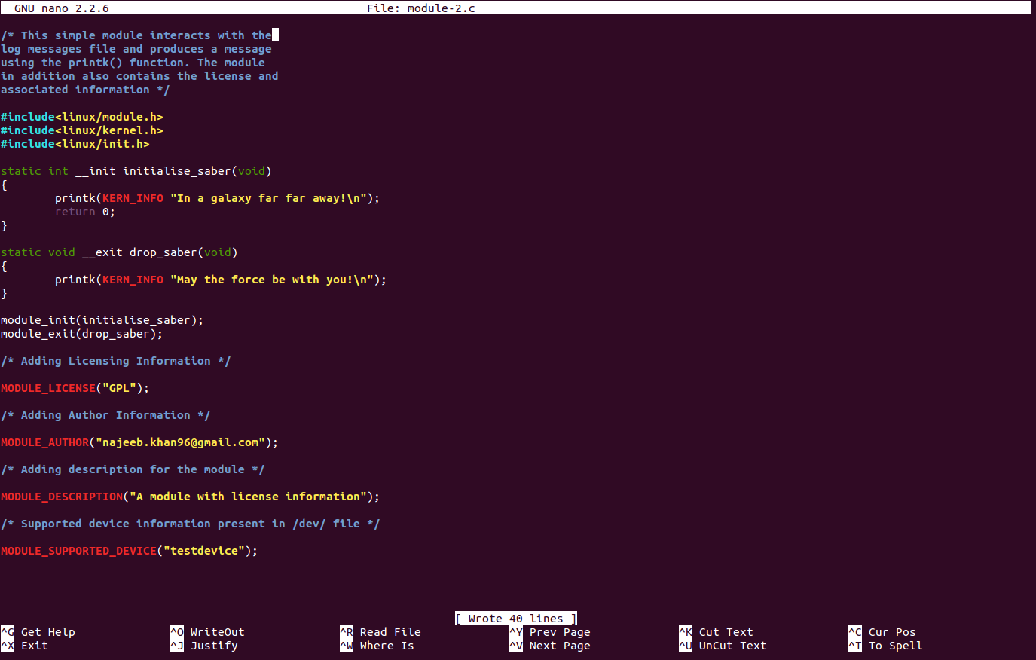

Slide 23
Writing a kernel module
A module which accepts command line args.
Purpose of the program
Importance of command line arguments
Understand how command line arguments are handled with the kernel module
Why use static data types while handling command line arguments
Printing messages on terminal in addition to kernel log.
Code structure of this particular module has some additives as compared to the past modules which are used for handling the values coming through command line. Following are the new additions
New header files for handling command line args
linux/moduleparam.h
linux/stat.h
Declaration for each command line variable and its parameter description using module_param() macro.
Description of command line variables using MODULE_PARM_DESC()

Slide 24
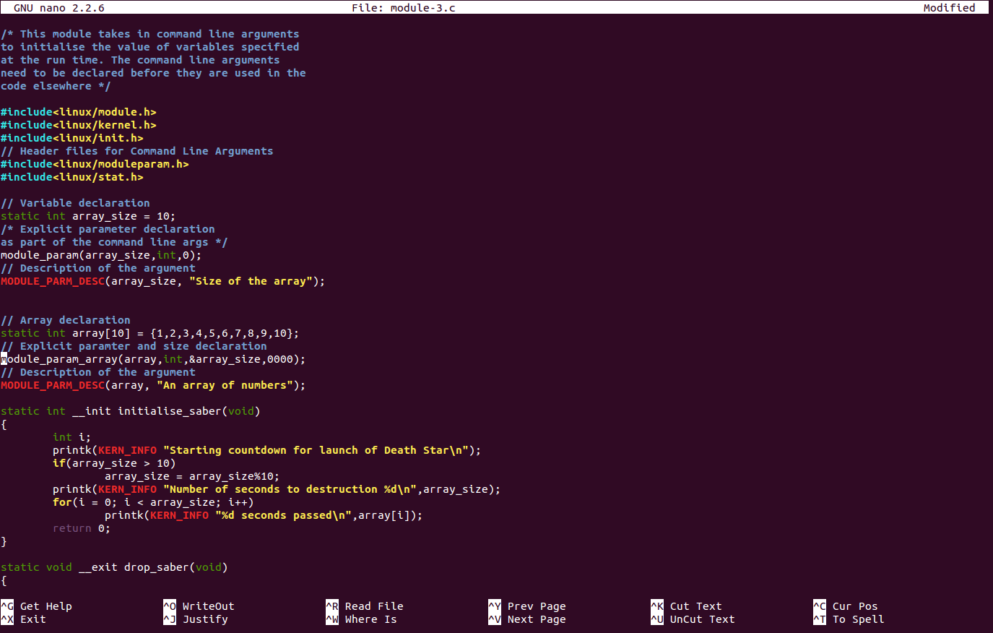

Slide 25
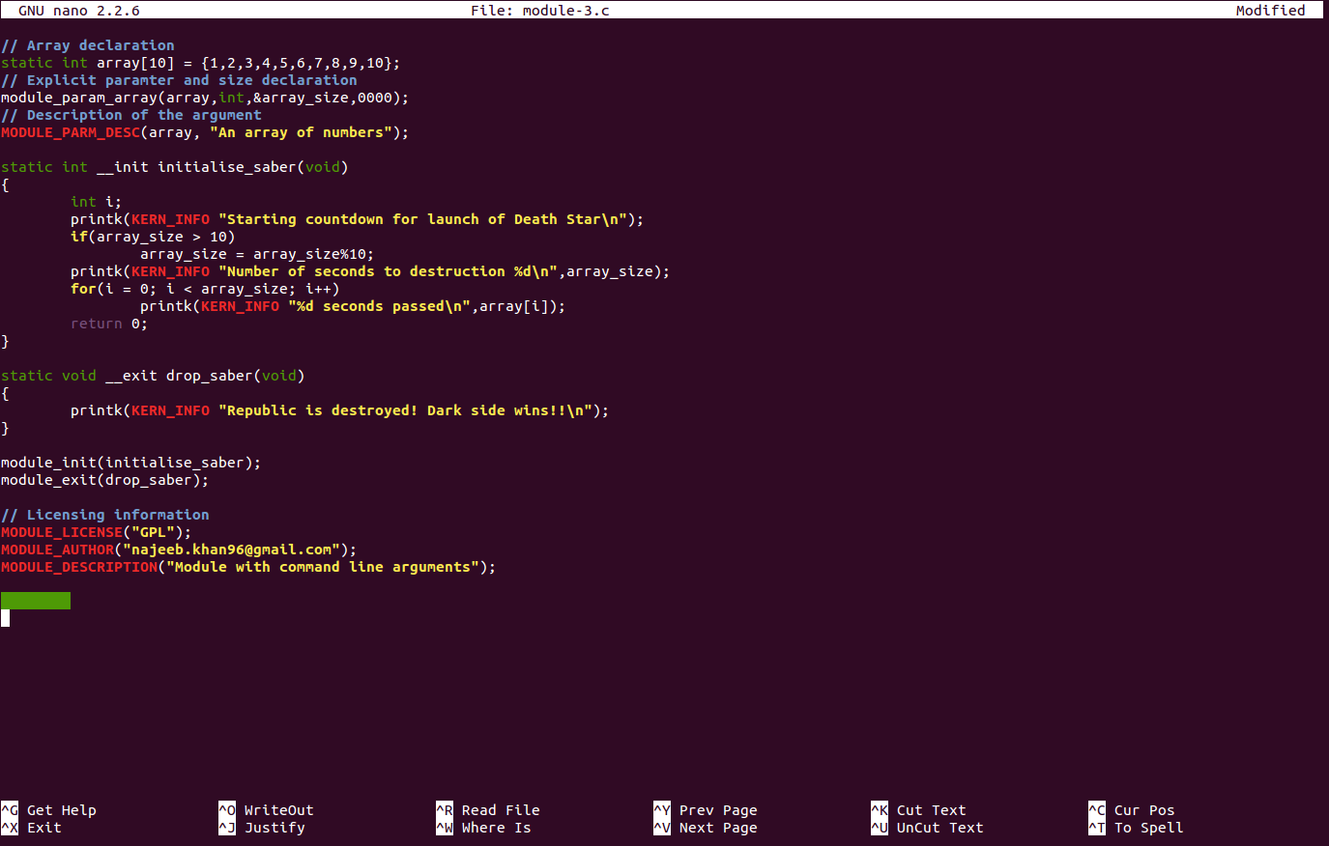

Slide 26
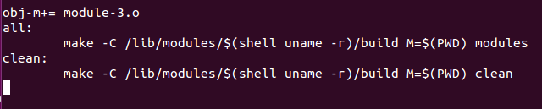
Compiling the Linux Kernel Module...
COMPILING A SIMPLE KERNEL MODULE
Compiling a kernel module is a two step process. First is the creation of the Makefile which contains the information instructing the shell to invoke compilation specific commands for the given program. The Makefile can make one or more file at the same time
The Makefile constructed is then executed using the make command which executes it.

Slide 27
Inserting the kernel module
Modules can be inserted using the insmod command.
If the module to be inserted is without any command line arguments then it can be inserted in the following manner sudo insmod ./module_name.ko
If the module takes in command line arguments then they are to be specified while inserting the module sudo insmod ./module_name.ko var_name = var_value ..

Slide 28
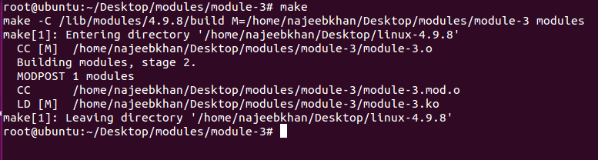
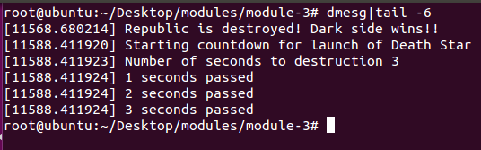
Compiling the kernel module
Output as part of the /var/log file

Slide 29
Questions?

Slide 30
Thank You
The presentation can be view and distributed accordingly. Any reproduction of the material is however prohibited
The code snippets used are available on the GitHub profile of najeeb97khan and contributions to the same are welcome.
Presentation: https://docs.google.com/presentation/d/18c2DXre7kah3m2rbNXBJSBmu_C4XnLfwYwOxrpAAwjw/edit?usp=sharing

